Slide 1
Review-4 on
PastPaperPro
Medhasvi-2410030040
Meghana-2410030136
Rohini-2410030516
Under the Guidance of
<Mr.Chiranjeevi>
<Designation>
Computer Science and Engineering Department
KL Hyderabad Off Campus, Aziz Nagar ,Hyderabad

Slide 2
Overview
Introduction
Objectives of the Project
Proposed Methodology/Architecture/Algorithm/Technique/etc
Implementation Details
Results (If any one objective is completed)
References

Slide 3
Introduction
PPP Hub is a web-based portal designed to provide access to previous year question papers in one place.
It allows students to view and download papers easily during exam preparation.
Faculty members can securely upload and manage question papers for specific branches and subjects.
The system uses role-based authentication — only verified student and faculty emails can access respective features.
It helps in organizing and managing academic resources efficiently.

Slide 4
Objectives of the Project
To create a centralized digital platform where students can easily access, view, and download previous year question papers for various subjects and branches.
To enable faculty members to securely upload and manage question papers through a role-based authentication system.
To ensure quick and organized retrieval of academic resources using filters such as branch, year, and subject.
To provide a simple, responsive, and user-friendly interface that enhances the overall user experience.

Slide 5
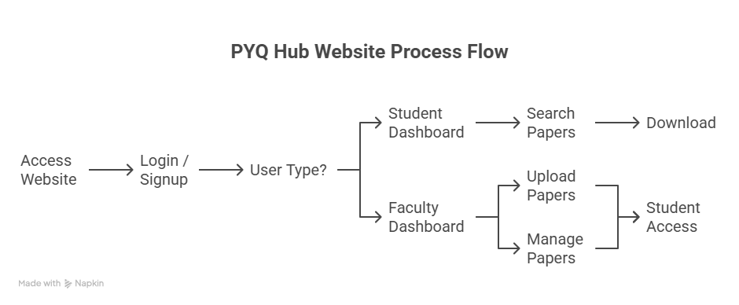
Proposed Methodology/Architecture/Algorithm/Technique/etc

Slide 6
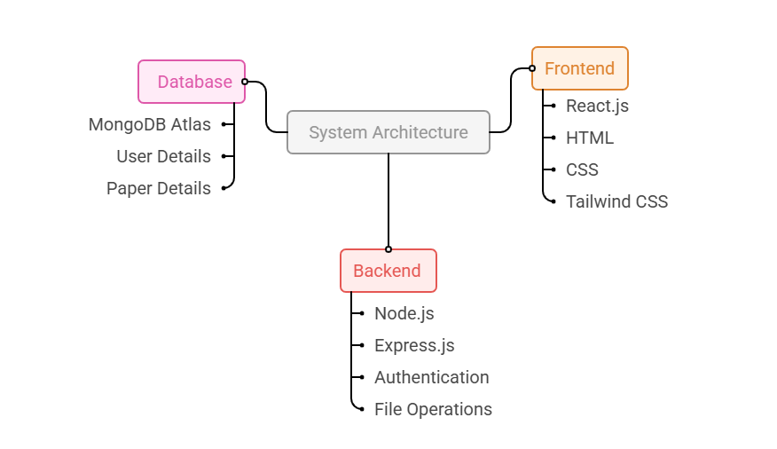
Implementation Details

Slide 7
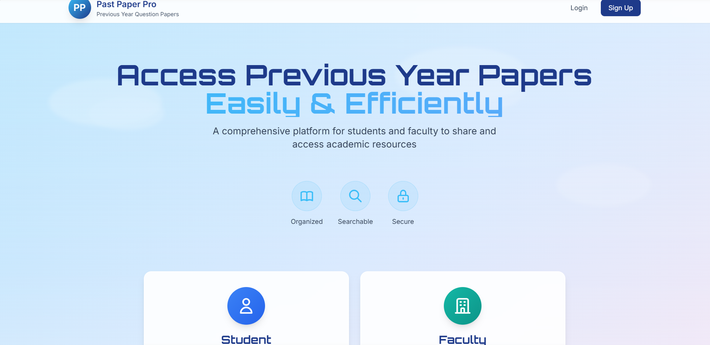
Results
The system ensures role-based access, allowing only authorized users to perform specific actions.
The system ensures role-based access, allowing only authorized users to perform specific actions.

Slide 8
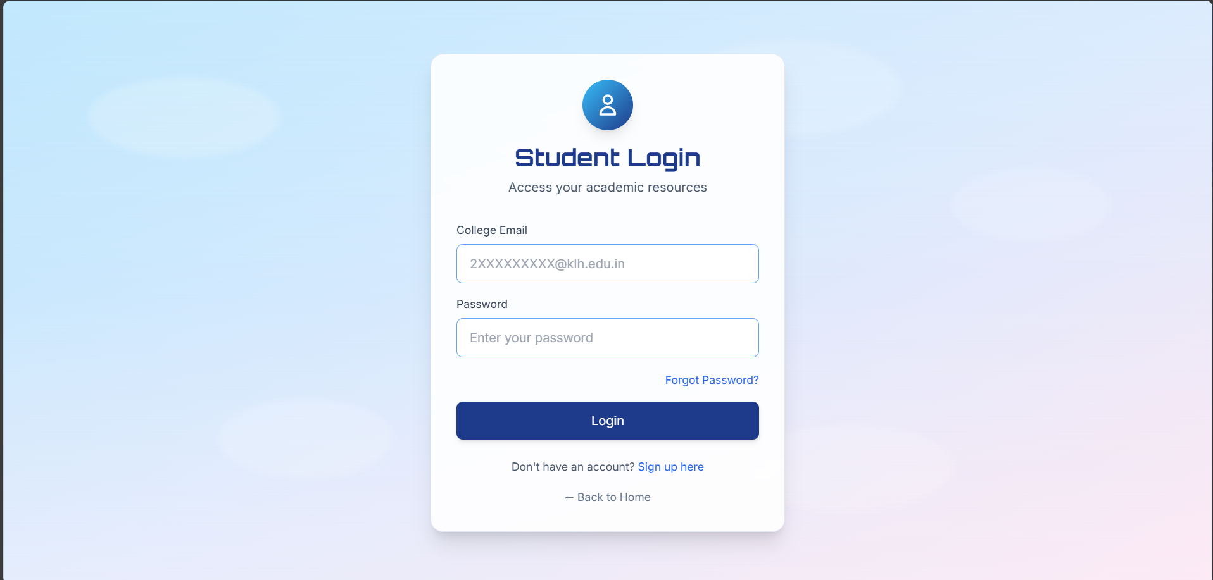
Results
The system ensures role-based access, allowing only authorized users to perform specific actions.
The system ensures role-based access, allowing only authorized users to perform specific actions.

Slide 9
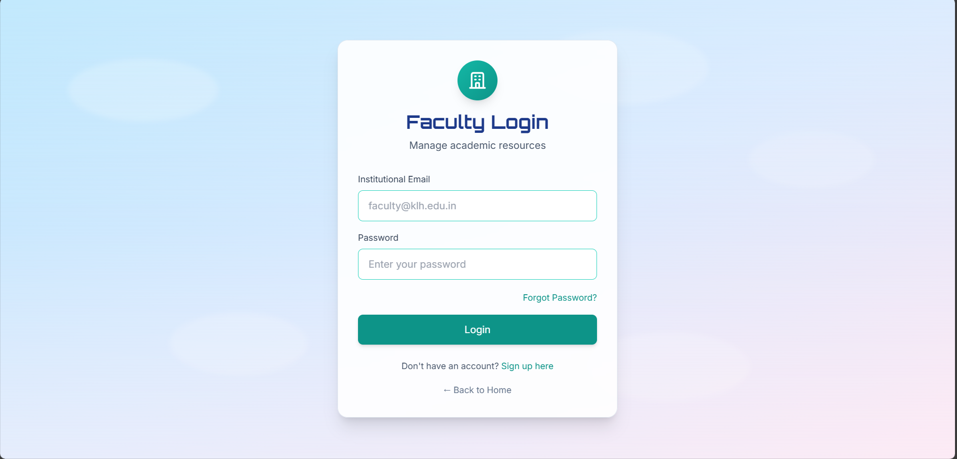
Results
The system ensures role-based access, allowing only authorized users to perform specific actions.
The system ensures role-based access, allowing only authorized users to perform specific actions.

Slide 10
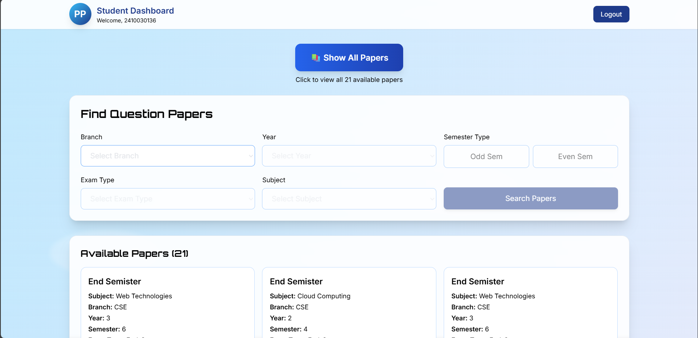
Results
The system ensures role-based access, allowing only authorized users to perform specific actions.
The system ensures role-based access, allowing only authorized users to perform specific actions.

Slide 11
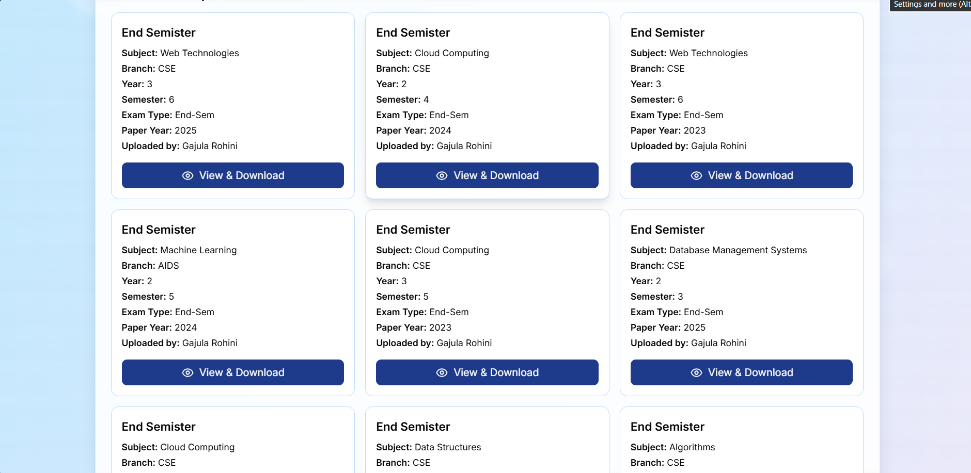
Results
The system ensures role-based access, allowing only authorized users to perform specific actions.
The system ensures role-based access, allowing only authorized users to perform specific actions.

Slide 12
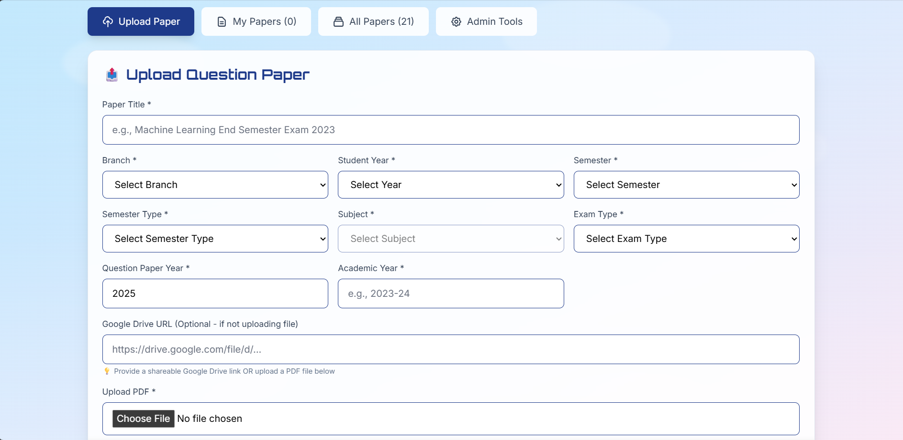
Results
The system ensures role-based access, allowing only authorized users to perform specific actions.
The system ensures role-based access, allowing only authorized users to perform specific actions.

Slide 13
Thank you

